Slide 1
Global Suicide Rates A glimpse at geographic, global and Demographic trends
Data Analytics Bootcamp (T/Th Session)
Nireesha Abbineni
Mrinmayee Kulkarni
Allyssa Calhoun

Slide 2
Our process
We wanted to dive into an issue that had global significance. One that warranted a deeper look into trends, demographics, geographic analysis, and possible correlations
We were able to find the data we needed on Kaggle.com
https://www.kaggle.com/russellyates88/suicide-rates-overview-1985-to-2016
The dataset was compiled from four datasets:
United Nations Development Program. (2018). Human development index (HDI). Retrieved from http://hdr.undp.org/en/indicators/137506
World Bank. (2018). World development indicators: GDP (current US$) by country:1985 to 2016. Retrieved from http://databank.worldbank.org/data/source/world-development-indicators#
[Szamil]. (2017). Suicide in the Twenty-First Century [dataset]. Retrieved from https://www.kaggle.com/szamil/suicide-in-the-twenty-first-century/notebook
World Health Organization. (2018). Suicide prevention. Retrieved from http://www.who.int/mental_health/suicide-prevention/en/
The data was very comprehensive, however we did find a glitch in missing statistics for Baby Boomers in 2010.
We reported the flaw in the dataset to the Kaggle dataset.

Slide 3
Clean UP PRocess
Nireesha
Nireesha add your process here since you did all the dirty work.

Slide 4
A global issue
Mrun
A look at global suicides over the last 10 years reveals the issue affects people everywhere
Insert visual here
Notes:
Insert a map of your country.

Slide 5
Top 3 Global findings from heat map
Mrun
Finding and data or stat to back it up
Notes:
Insert a picture of one of the geographic features of your country.

Slide 6
A deep dive into the top ten countries
Countries with the highest number of suicides
United States
Russian
Japan
South Korea
Germany
Brazil
France
Ukraine
Poland
Mexico

Slide 7

A wide spread issue
Observation and stat
#2
#3
Bar Graph
Notes:
Insert a picture illustrating a season in your country.

Slide 8

Correlation between GDP and Suicide Rates
We were interested to determine if there was a statistically reliable correlation between GDP and Suicide Rates
Hypothesis was that the richer the country, the greater the rate
Based on Maslow’s Hierarchy of Needs
Fact: Hypothesis true? Should we use Null Hypothesis here?
Notes:
Insert a picture of an animal and or plant found in your country.

Slide 9
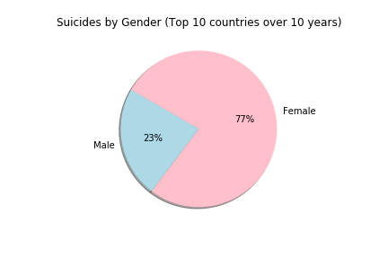
A look at gender disparity—(top 10)
We were surprised how much more prevelant suicide was among females
Females accounted for 77% of all
suicides
None of the top 10 countries were significantly more lopsided than others
Notes:
Add key points in the history of your country to the timeline.

Slide 10
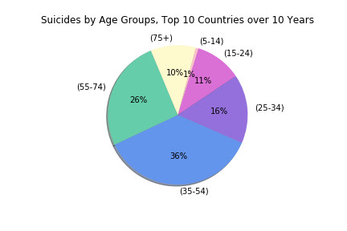
Are certain age groups more susceptible to suicide than others?
The 35-54 age group accounts for the largest segment to succumb to suicide
Perhaps because this is the age where we feel the strongest pressures financially, career-wise, and maritally
At first glance, the 75+ group, comprising 10% of all suicides was surprising
A cursery look at other research suggest a terminal health diagnosis link to be primary cause among this age group
The saddest finding was the 10K children in the (5-14) bracket
Notes:
Insert a picture illustrating a custom or tradition here.

Slide 11
Histogram slide
Explain how laws are made and changed in your country. Tell how people are chosen to lead the country.
Notes:
Insert a picture of the head leader of your country.

Slide 12
United States

Slide 13
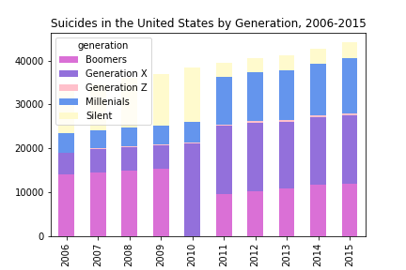
Suicides in the US by Generation
Gen Xers warrant a deeper dive into life stressers and mental issues in that generation
Part of the increase can be explained by them moving into the most dangerous age group for suicides, (35-54)
Numbers are especially alarming when this generations has 15 year birthyear span vs. some of the others (up to 21years)
The data appears to follow 2 separate trend lines. One from 2006-2010 and the other from 2011-2015
Perhaps separate original source datasets were used to compile original dataset
Notes:
Insert a picture that illustrates some part of your country’s economy.

Slide 14
Statistical Analysis
Any statatistcal analysis info here
Notes:
Insert a picture of one of the points of interest for your country.

Slide 15
Conclusions
All
Look to Project Proposal for questions and provide answers here
Include 1 World Wide
Include 1 Top 10
Include 1 US

Slide 16
Conclusions
All
Dataset limitiations found
Data Analytics Learnings

